Slide 1



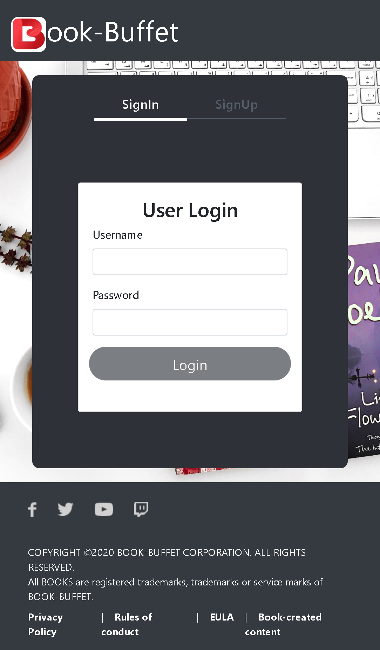
BookHive
Team-4:
Chirachapala Sayyed
E Vaishnavi
Dasari Charishma
Bandaru Meghamala

Slide 2
Outline
Problem Statement
Objective
Technology and Tools Used
Project Overview
Architecture
Project Flow
Conclusion

Slide 3

Problem Statement
Customer is busy in his/her daily life and wants to visit bookstore to access the books without stepping outside and the sellers are not satisfied with current market scenario.

Slide 4
Objective
Our objective is to provide best user experience to our customers so that they can buy books online without stepping outside. This application will also be focusing on seller site.

Slide 5







Technologies and Tools Used

Slide 6
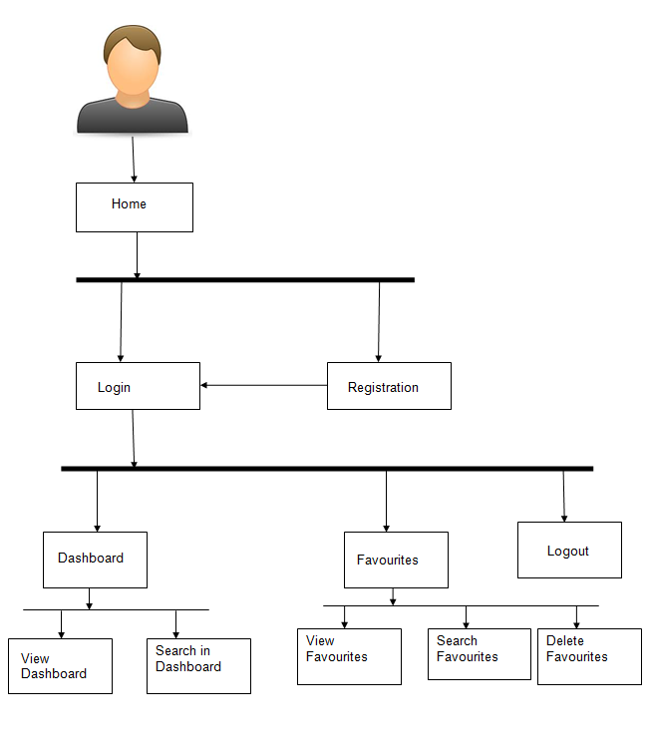


Project Flow
Home
Book
Search
Login
View
Recommends
User
Add to cart
Search Books
View User

Slide 7
Project Overview

Slide 8
Admin Service
In this service the admin can login into the book hive app.
Now the admin can add the books which are visible for the user
Admin also has the ability to delete books and Update books.
Admin can also view all the orders placed by users.

Slide 9
User Service
In our application first the user can register himself and then he can login.
All the books which are added by the admin can be visible to the user.
If user wants to buy for future use he can add into the cart.
User can also order the books which he likes.

Slide 10
Book Service
All the books added by the admin will be visible to the user on the user landing page.
The details of the book which are visible to the user are:
1.Book Title
2.Book Description
3.Book Image
4.Amount in dollars

Slide 11
Cart Service
Whenever the user add a book to cart it will be visible in “My Cart” on the nav bar.
The user can also place an order of the book which he added to the cart.
The user can also clear the cart if he/she requires.
The cart-service will allow the user to check how many items(books)are available in the cart and what is the total amount of books which he/she added to the cart.

Slide 12
Order Service
When the user clicks on the order button the application requires the user to fill some details ie Delivery Address
The details to be added by the user are:
Street Address
City
State
Postal ZipCode
Next he can place an order

Slide 13




Project Overview
Book API Service
User API Service
Login
User
HOME
Search
Cart
Mongo Db
My Sql
My Sql

Slide 14
Architecture

Slide 15
Architectural Diagram
USER SERVICE
MySql
Login
POST
POST /GET/
DELETE
BOOK SERVICE
MySql
POST/ GET/DELETE
Front End
Angular
POST/ GET
CART SERVICE
MongoDb
POST/ GET/DELETE
ORDER SERVICE
MongoDb
GET/DELETE
GET/DELETE

Slide 16
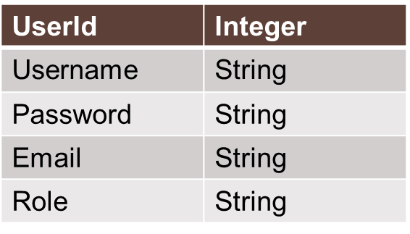
POJO Classes
BOOK:
USER:
Title | Type
BookId | Long
BookTitle | String
BookDescription | String
BookImageUrl | String
BookPrice | String

Slide 17

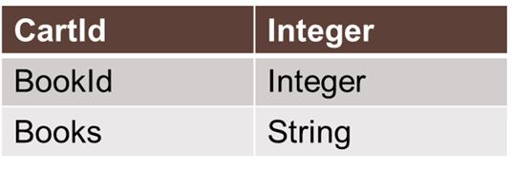
ORDER
OrderNumber | Integer
UserId | Integer
DeliveryAddress | String
DeliveryStatus | String
Books | List of Strings

Slide 18
Now Let’s See Execution Part

Slide 19
Conclusion
Online access to huge number of books as well as availability of variety of selection tools has helped public in developing high quality book collections.
The Book Hive helps the users to view available books in different book stalls and place order.

Slide 20
Thank You

